Slide 1


Gaming Sentiment Analytics For Playstation

Slide 2
Deployment

Slide 3















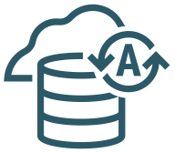

Detailed Sony PlayStation Platform Diagram
OCI Region San-Jose
Internet
Fault Domain 1
Internet Gateway
VCN-0 (Analytics)
Subnet
00.0.00.0/00
VPN
DRG
Analytics Cloud
129.148.160.103
WAF
SG-0
VCN-20220214-1730 (Front)
Policies
Users
Subnet
00.0.00.0/00
IDCS
SG-1
Auditing
3rd Party Cloud
SOCIAL AGENTS
155.248.206.63
Logging
VCN-2 (Back)
Subnet
00.0.00.0/00
Object Storage
SG-3
Object Storage
On-Premises
SENTIMENTATP
SG-2
CPE

Slide 4
PlayStation Dashboard

Slide 5
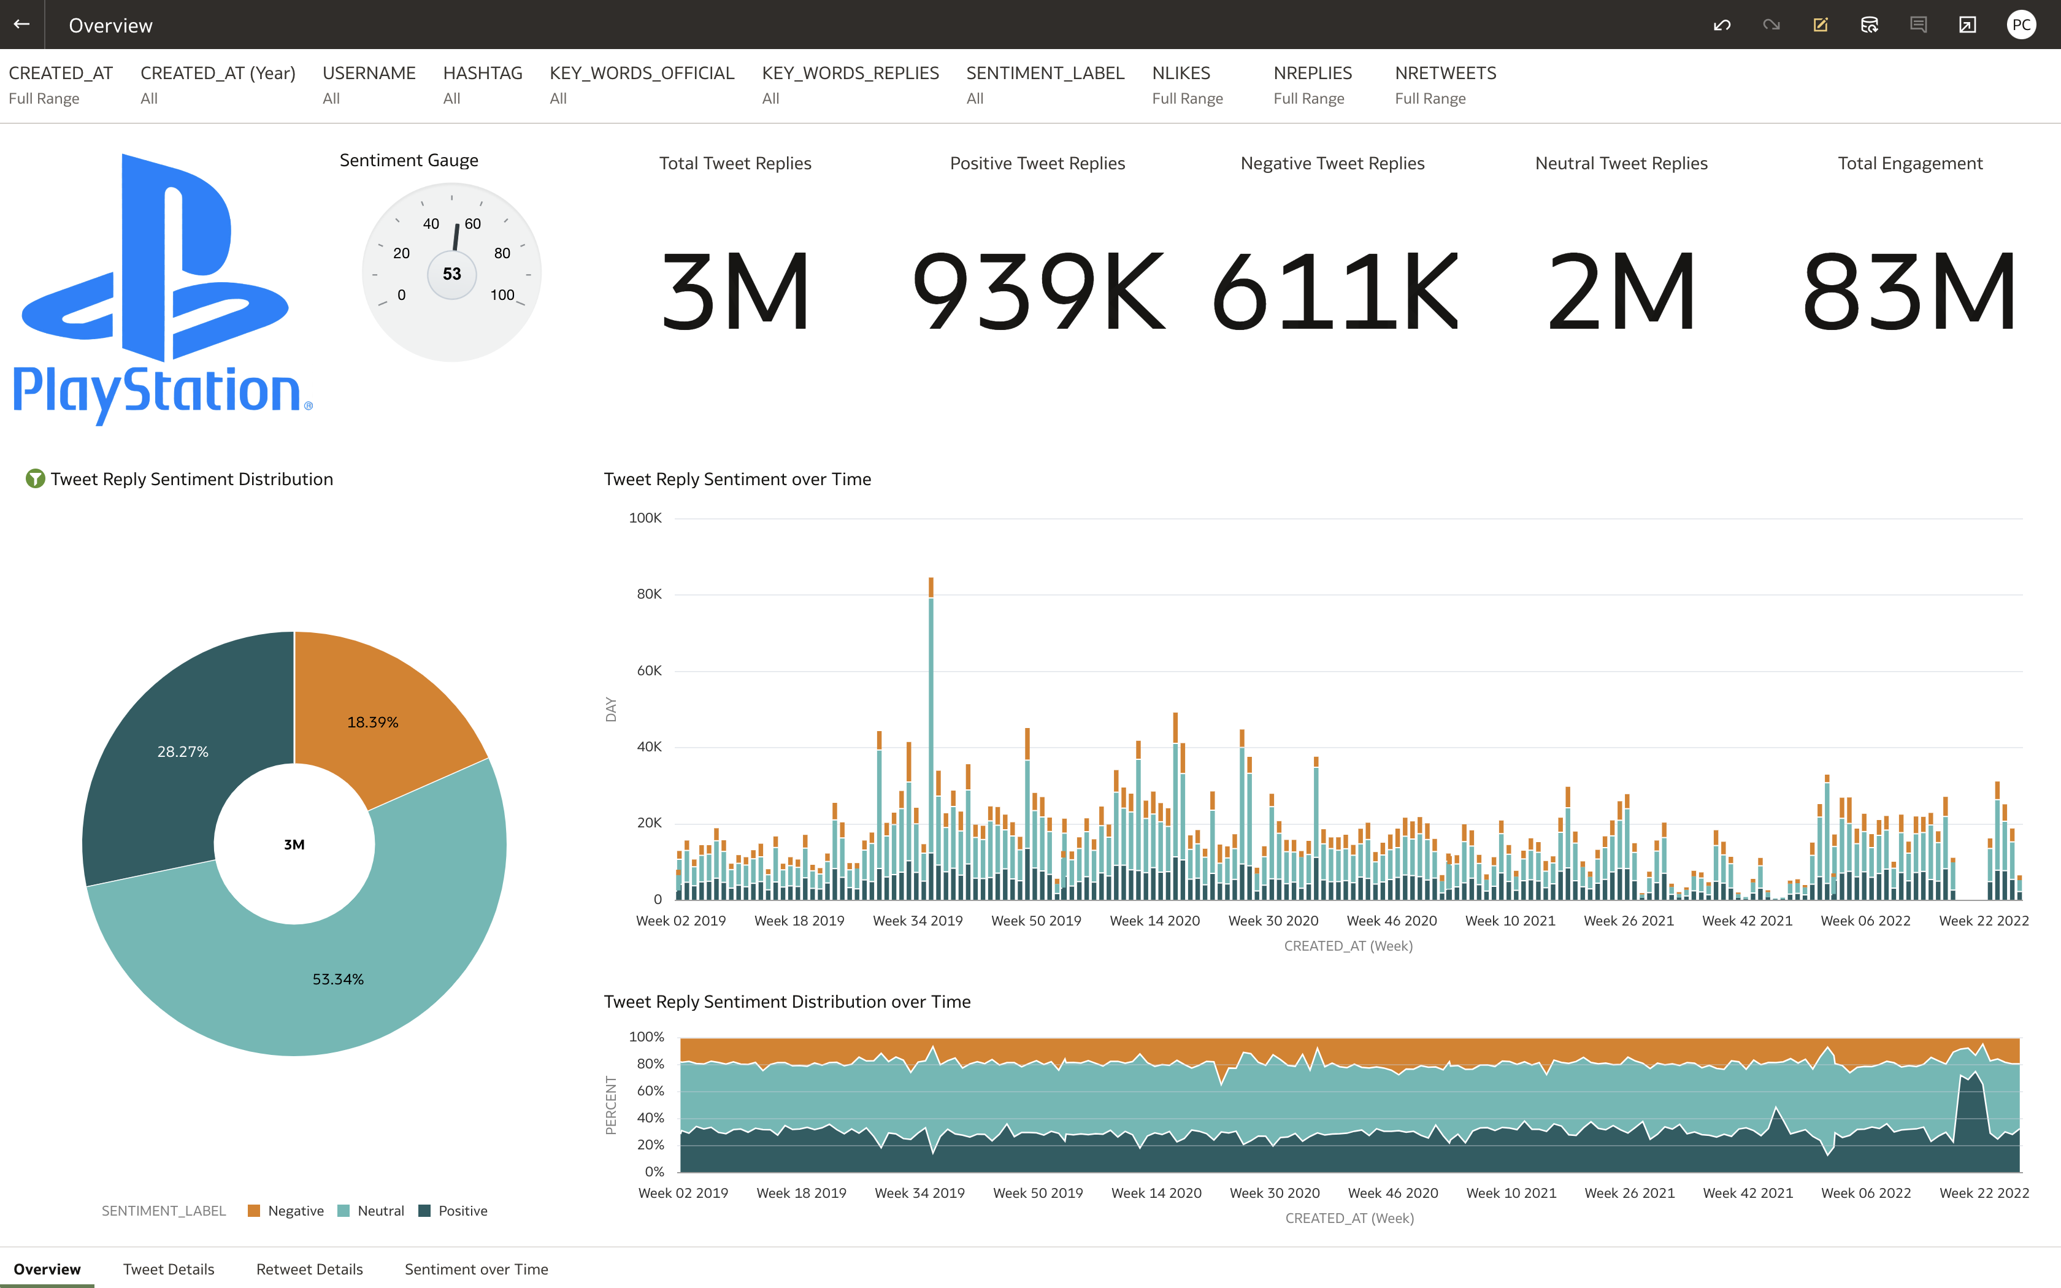
Main Overview with all Twitter Channel Streams Channels Distribution
Configure some Filters
Positive & Negative Analysis
Daily Distribution
5
Copyright © 2022, Oracle and Sony Playstation

Slide 6
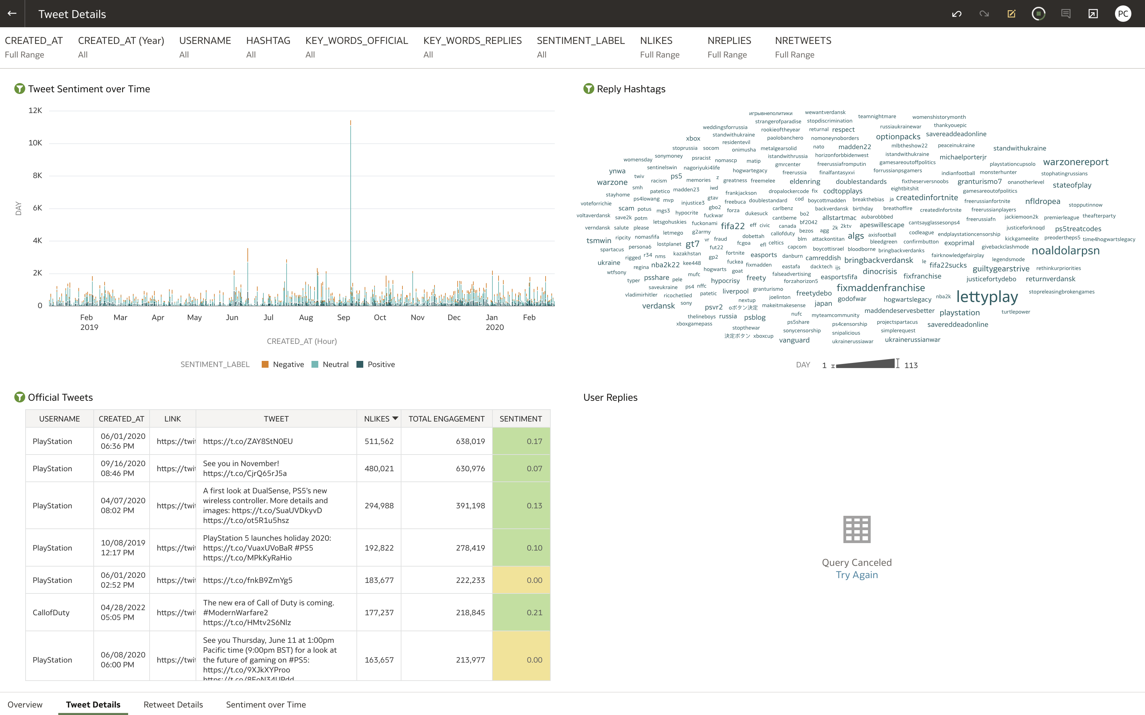
Tweet Details Canvas Tweets Distribution per hashtags
Replies Hashtags Analysis
Tweets Details
6
Copyright © 2022, Oracle and Sony Playstation

Slide 7
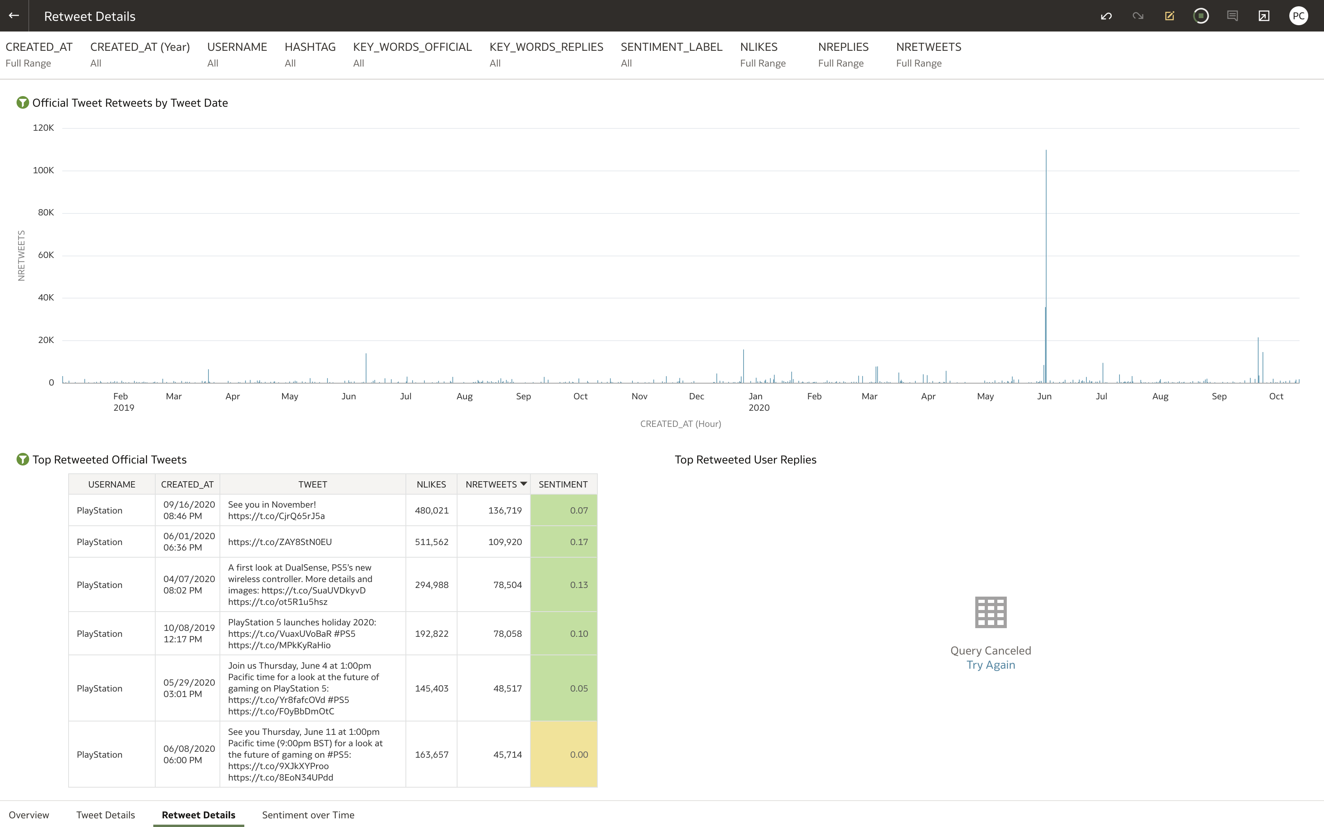
Retweet Details Canvas Retweets Distribution per hashtags
Retweets Hashtags Analysis
Retweets Details
7
Copyright © 2022, Oracle and Sony Playstation

Slide 8
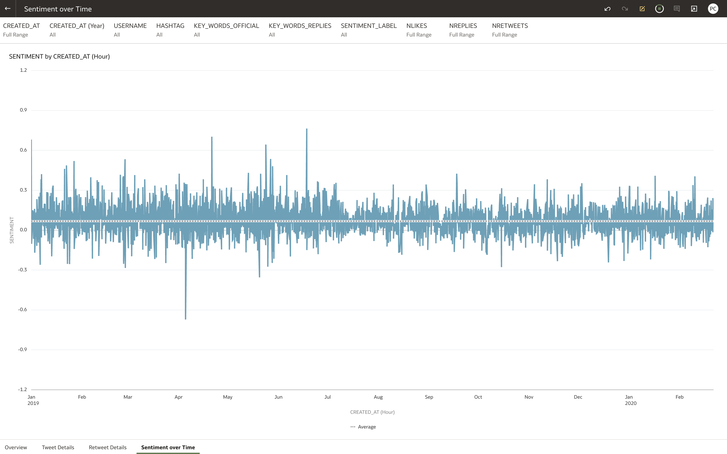
Sentiment over Time Canvas Sentiment Distribution
8
Copyright © 2022, Oracle and Sony Playstation

Slide 9
Gaming Sentiment Analysis Maintenance Tool

Slide 10
Twitter Channels segmented by publisher
See all Twitter channel to configure in the Maintenance Tool:
PlayStation Channels
PlayStation Global Twitter
PlayStation EU Twitter
PlayStation Global FB
PlayStation EU FB
EA Madden
Madden NFL 22 Twitter
Sumo
Sackboy: LittleBigPlanet Twitter
Sackboy: LittleBigPlanet FB
Activision
Call of Duty Twitter
AcrSystemWorks
Guilty Gear Strive Twitter
Epic
Fortnite Competitive Twitter
EA Apex
Apex Legends Esports Twitter
EA FIFA
EA Sports FIFA Twitter
Ubisoft
Rainbow Six Esports NA Twitter
2K
NBA2K Twitter
NBA2k_MyTeam Twitter
Warner Bros
NRSEsports Twitter
Bandai Namco Tekken
Bandai Namco Esports Twitter
10
Copyright © 2022, Oracle and Sony Playstation

Slide 11
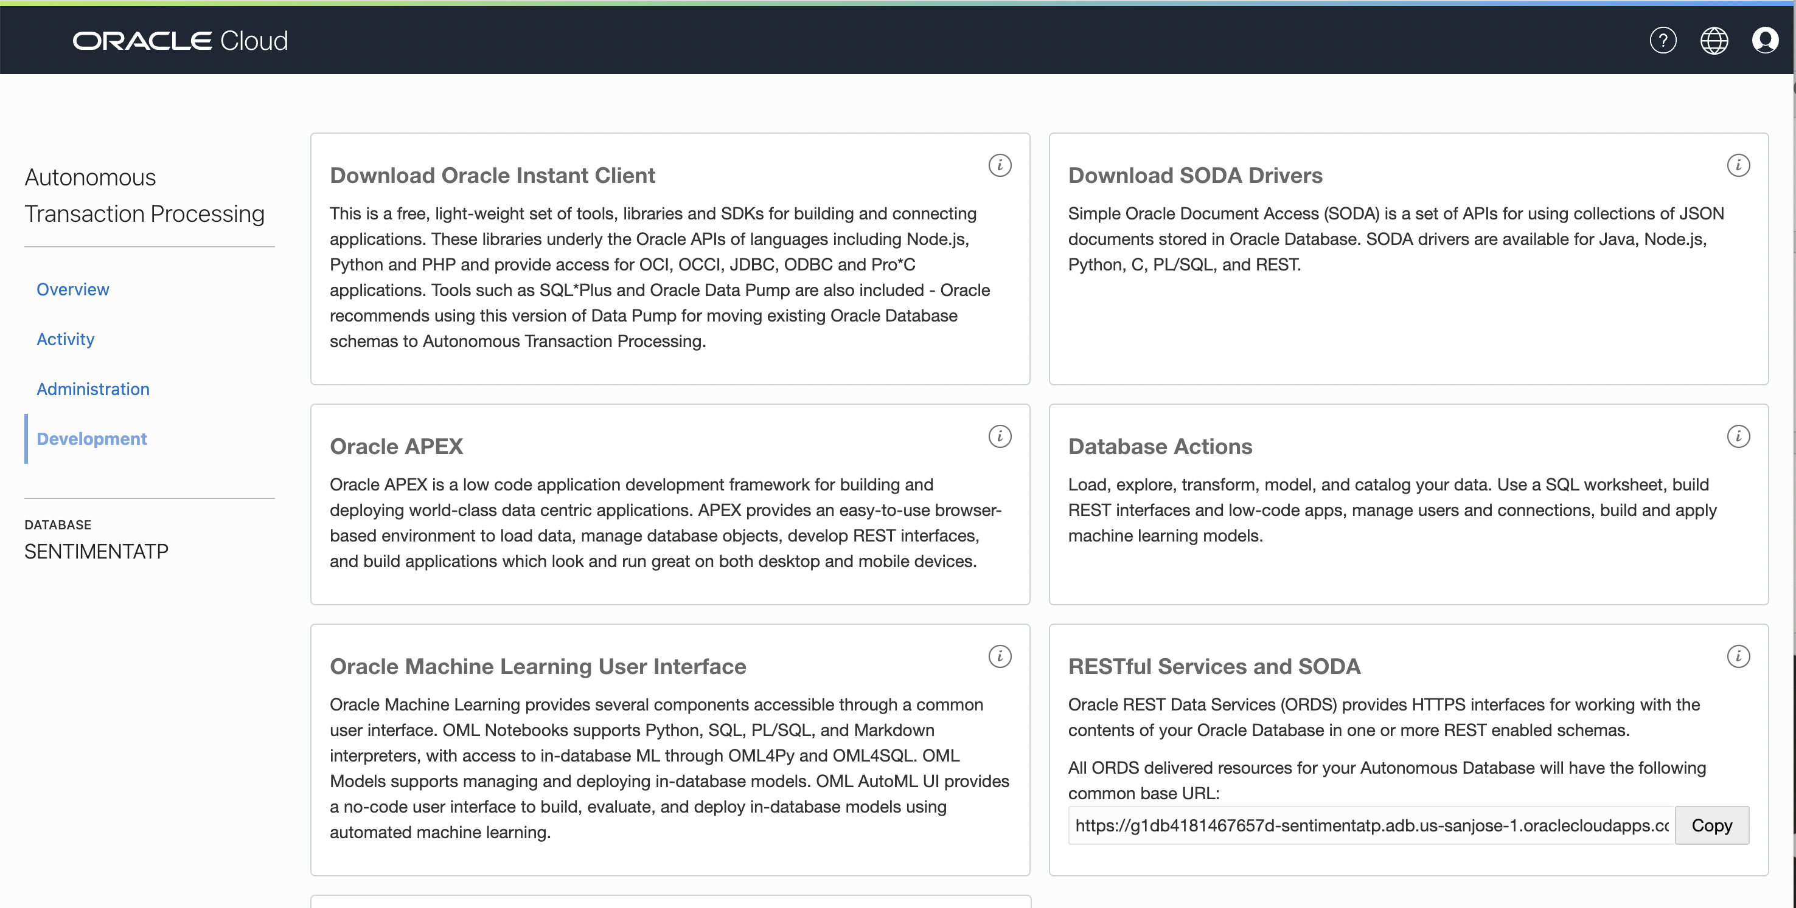
Access to APEX Application from ATP
1
2
Click here
Click “Oracle APEX” Service

Slide 12
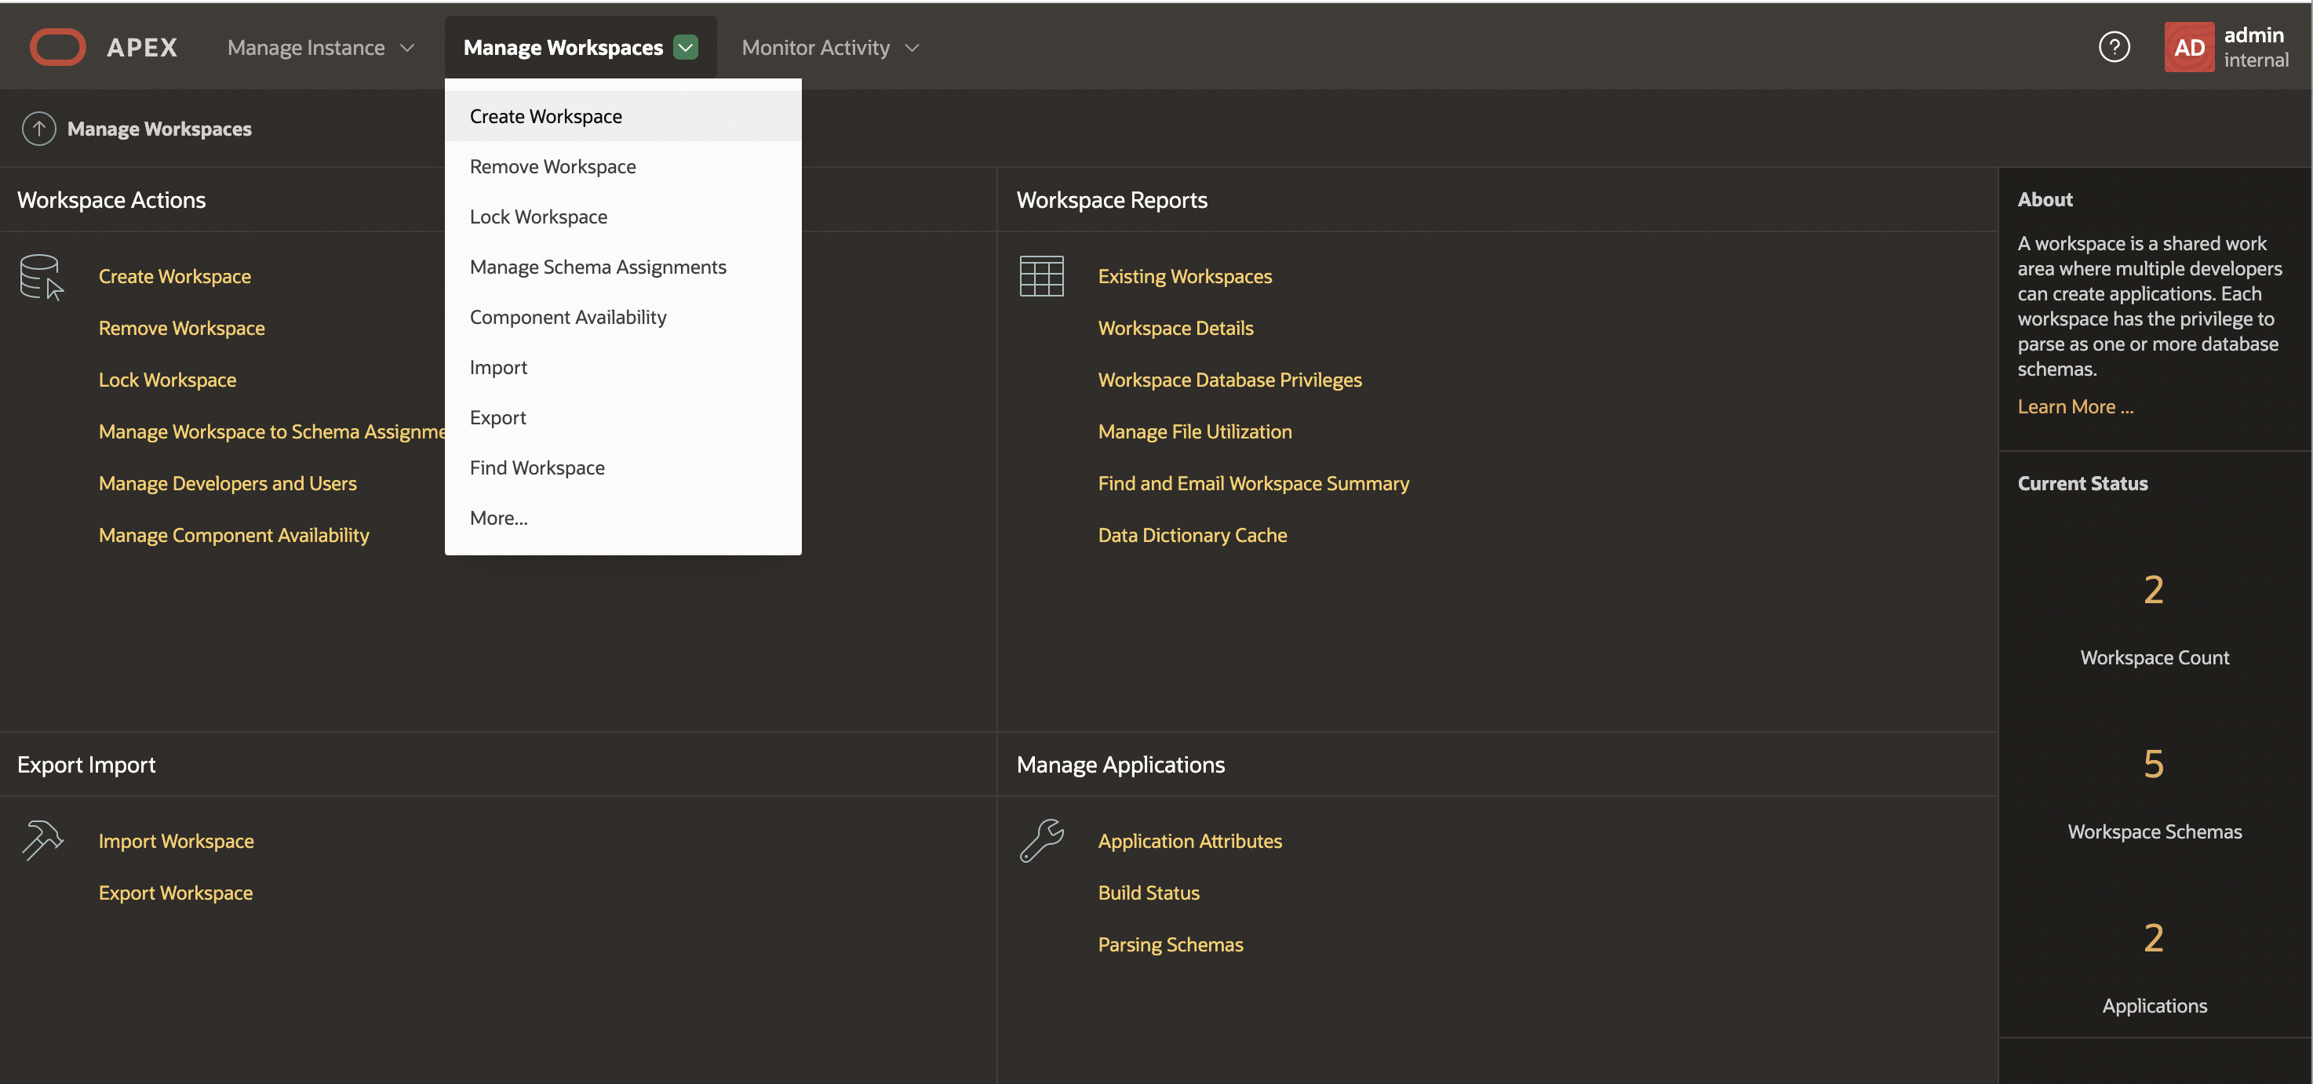
Creating Workspace
1

Slide 13
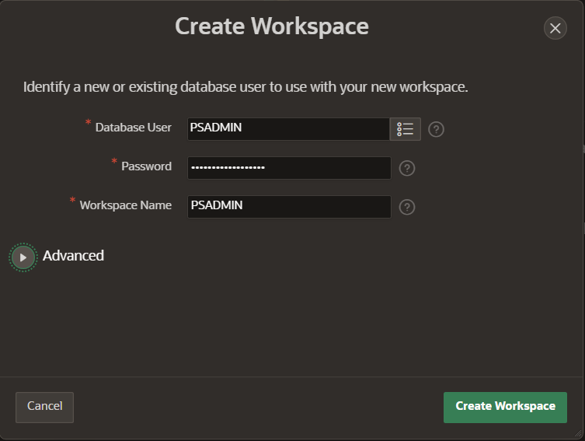
Widget to create a new workspace

Slide 14
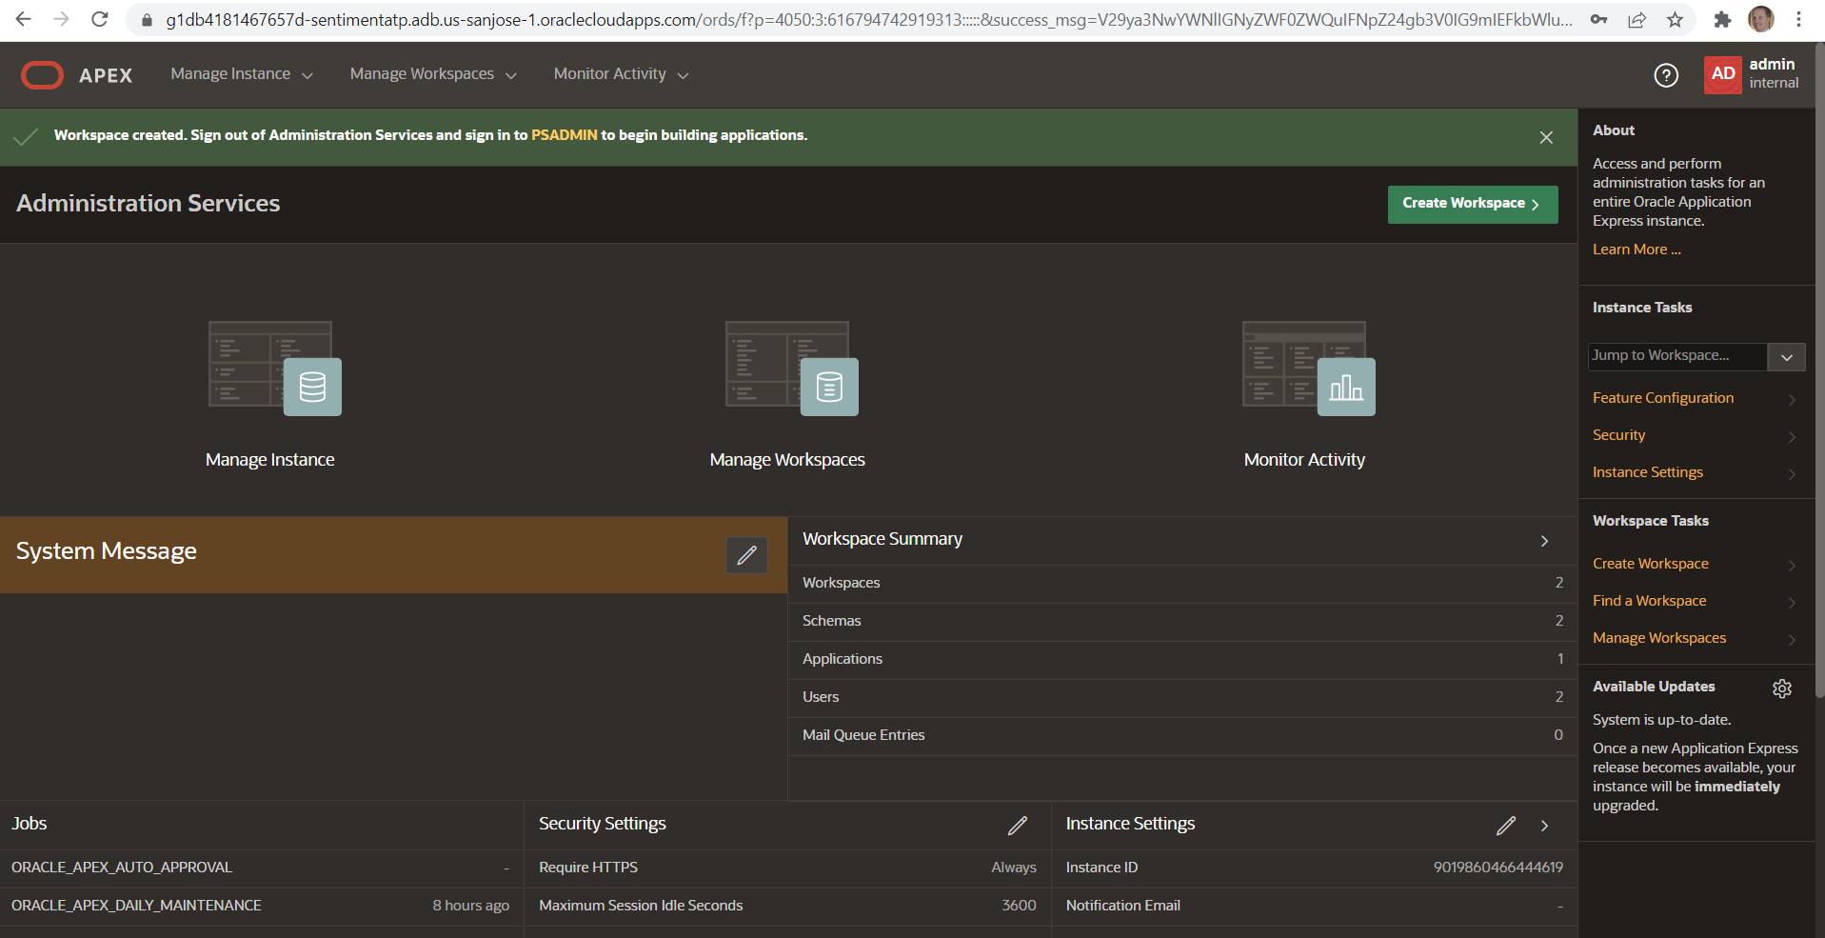
Workspace created
1

Slide 15
Developing your App for Gaming Maintenance

Slide 16
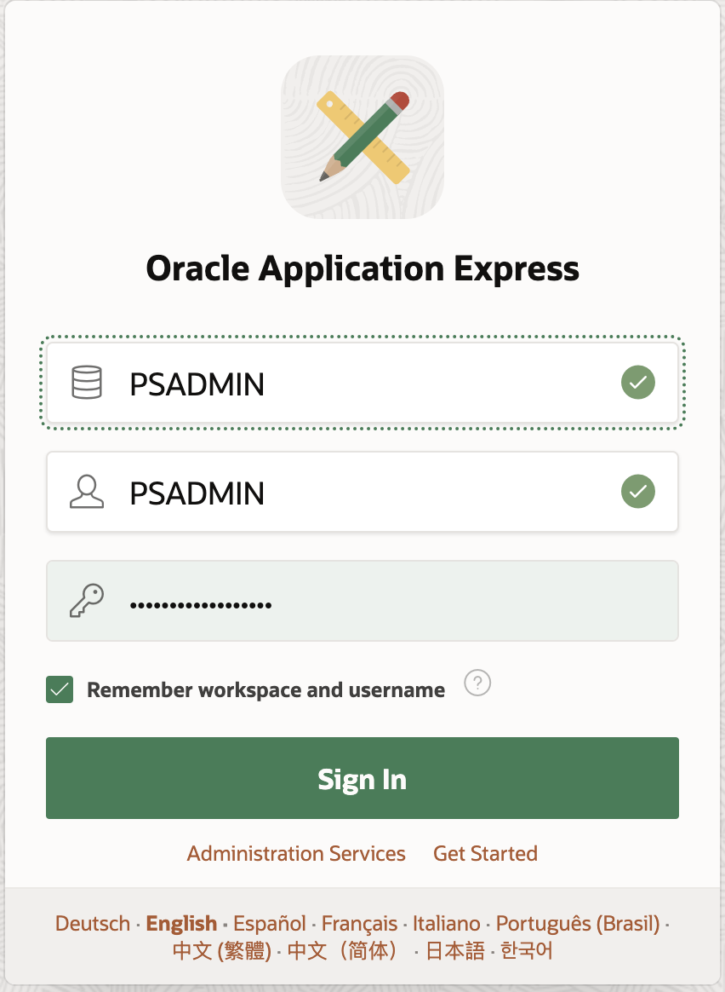
Connect to your new Workspace to develop your App
1
Select the workspace name

Slide 17
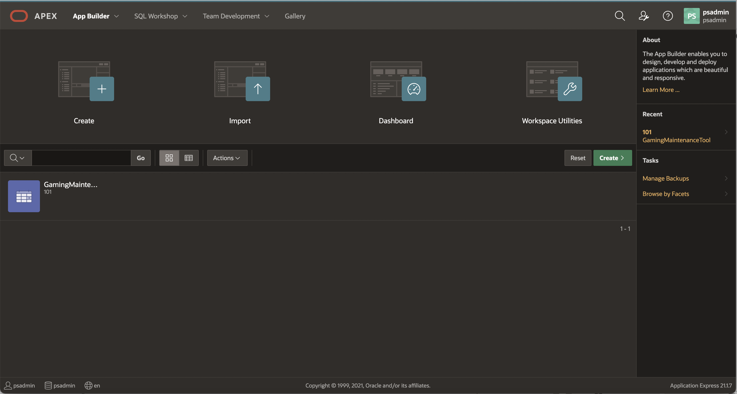
Developing your App for Gaming Maintenance Tool
Click on “GamingMaintenanceTool” App to modify or develop new pages.

Slide 18
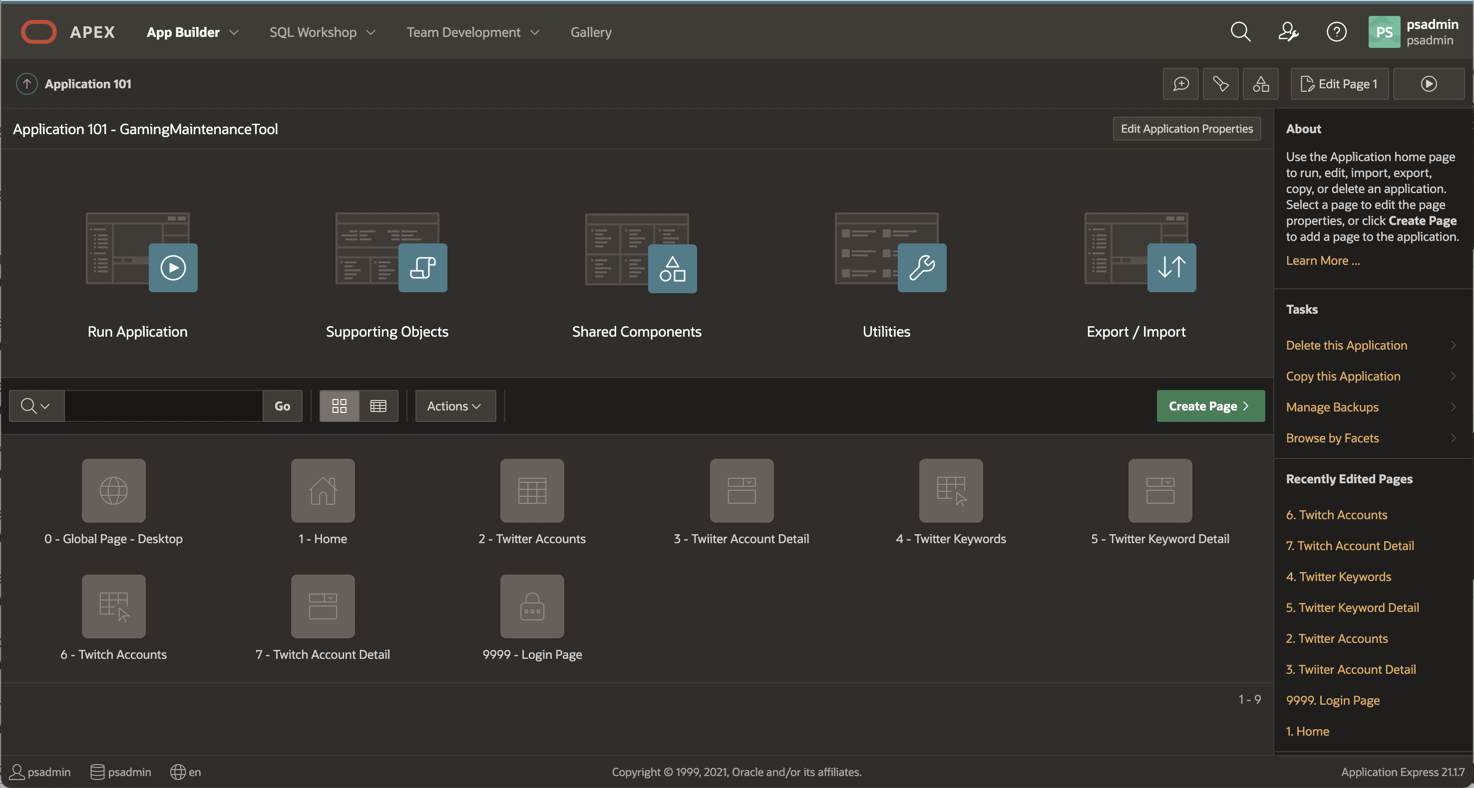
Develop Gaming Maintenance Tool Pages
You can see all pages implemented for “GamingMaintenanceTool” App.

Slide 19
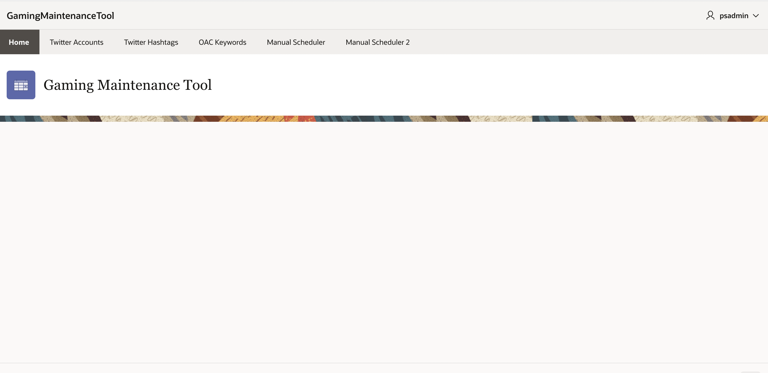
Gaming Maintenance Tool Home Page
You can see all Tabs for “GamingMaintenanceTool” App.

Slide 20
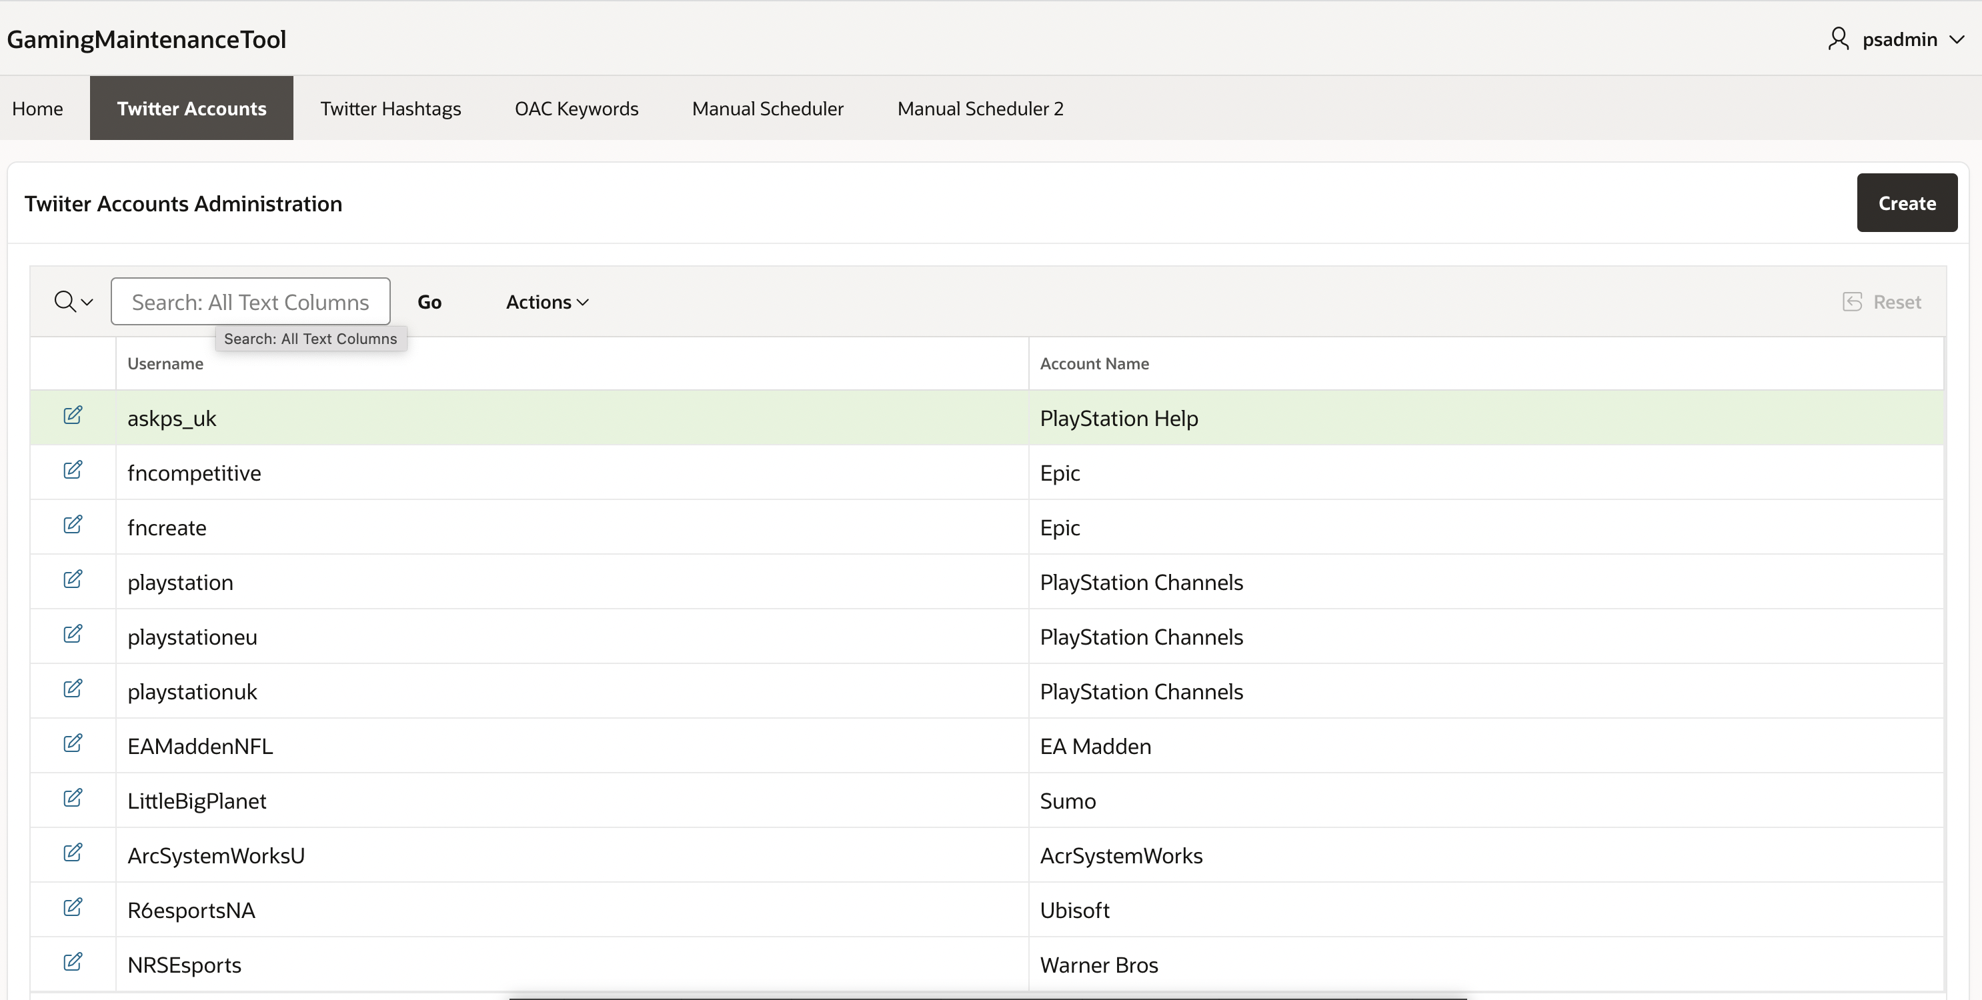
Twitter Accounts Maintenance
1
Select “Twitter Accounts” Tab.
2
Click to modify.

Slide 21
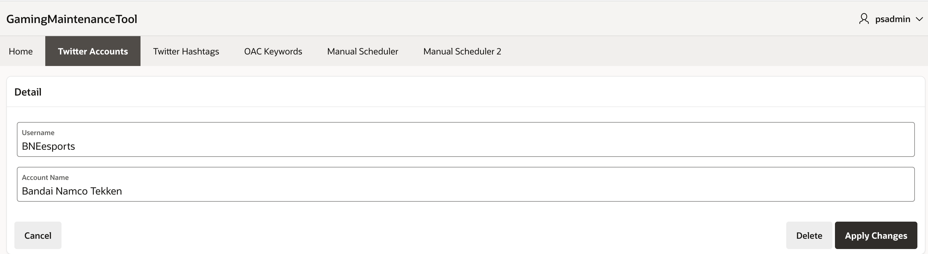
Twitter Account Detail Maintenance

Slide 22
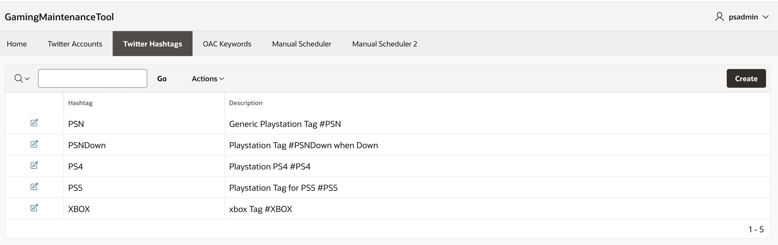
Twitter Hashtags Maintenance
1
Select “Twitter Hashtag” Tab.
2
Click to modify.

Slide 23
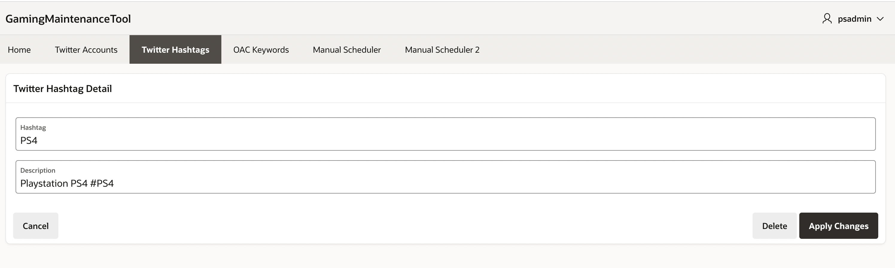
Twitter Hashtags Maintenance Detail

Slide 24
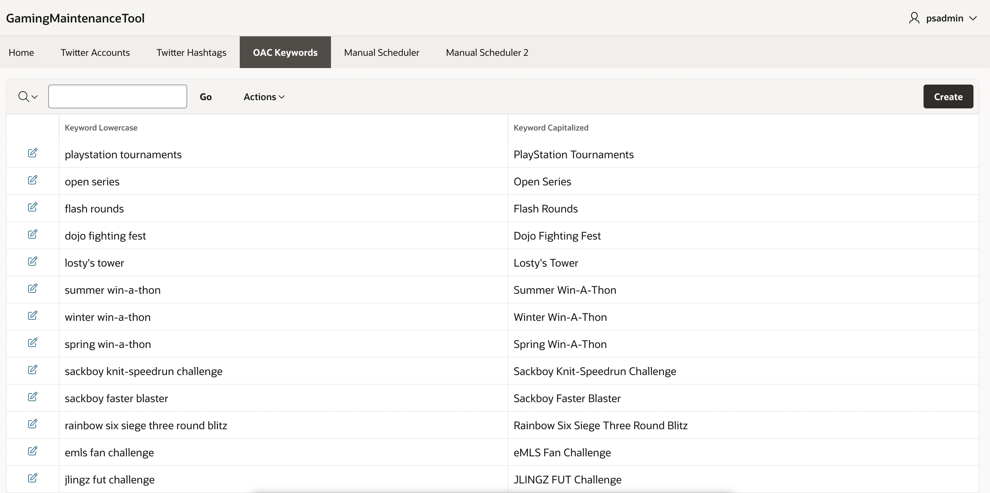
Twitter OAC Keywords Maintenance
1
Select “OAC Keywords” Tab.
2
Click to modify.

Slide 25
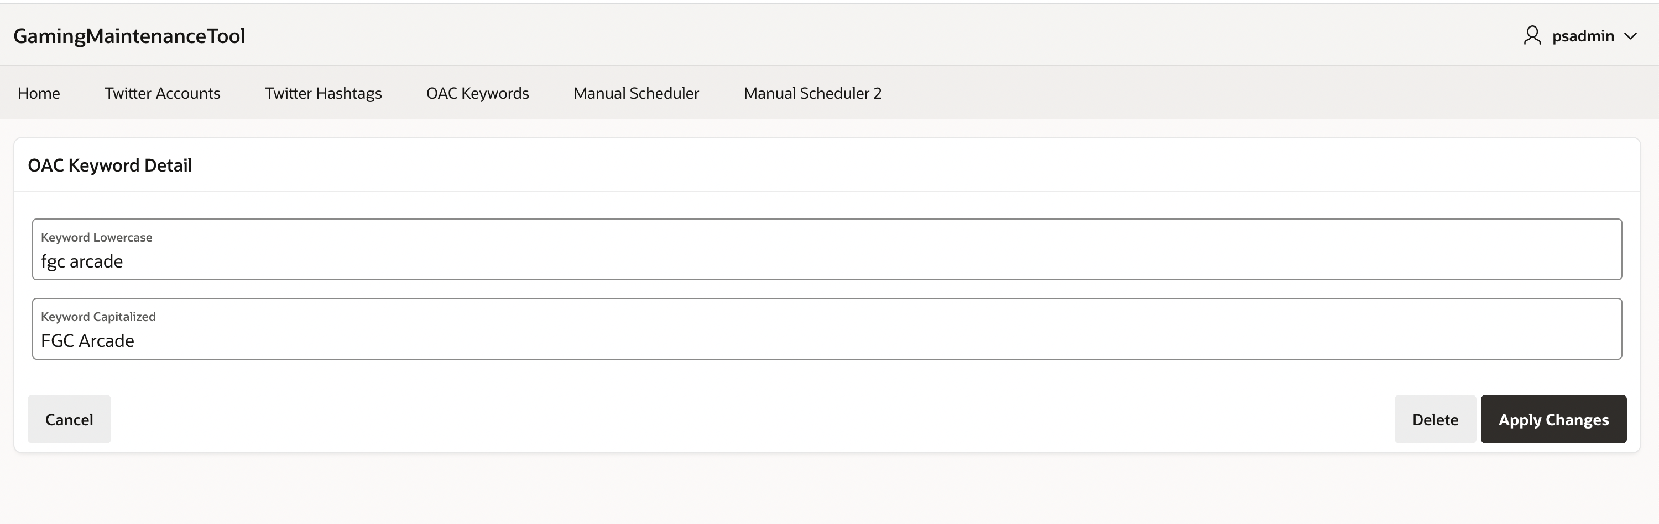
Twitter OAC Keyword Detail Maintenance

Slide 26
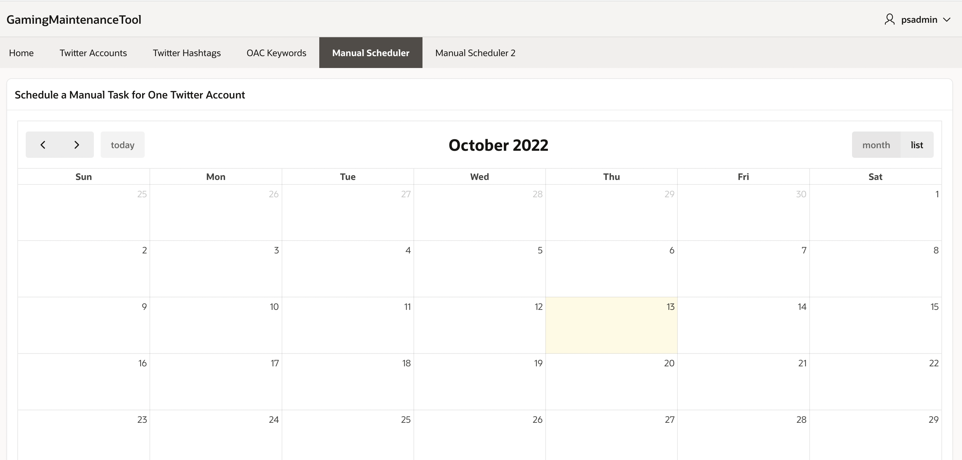
Twitter Scheduler for one Twitter Account

Slide 27
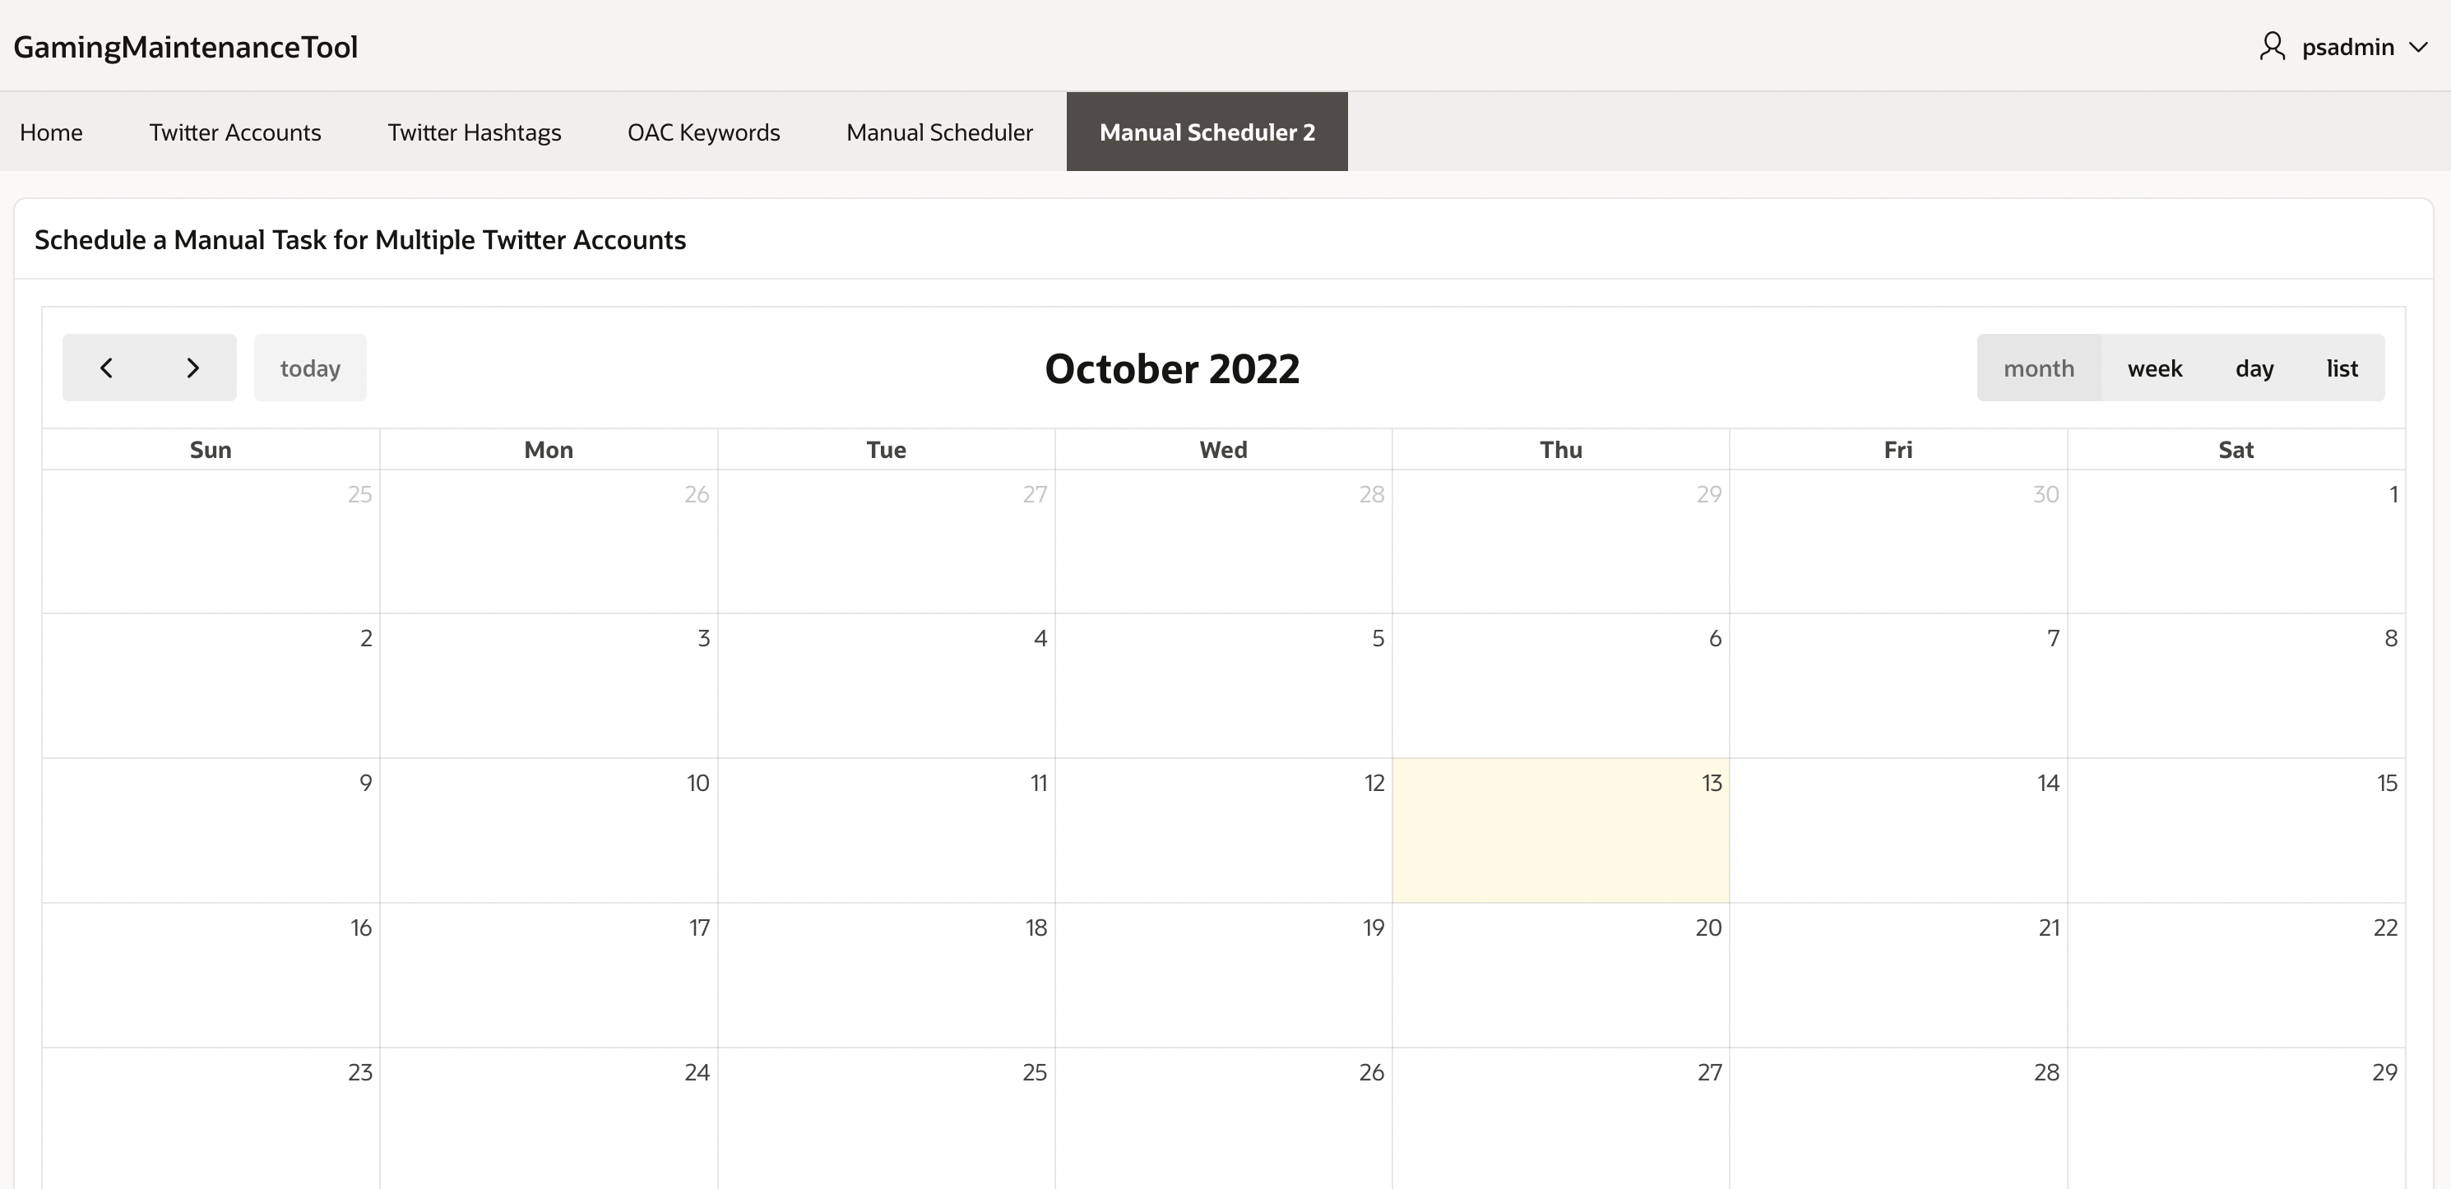
Twitter Scheduler for Multiple Twitter Accounts

Slide 28
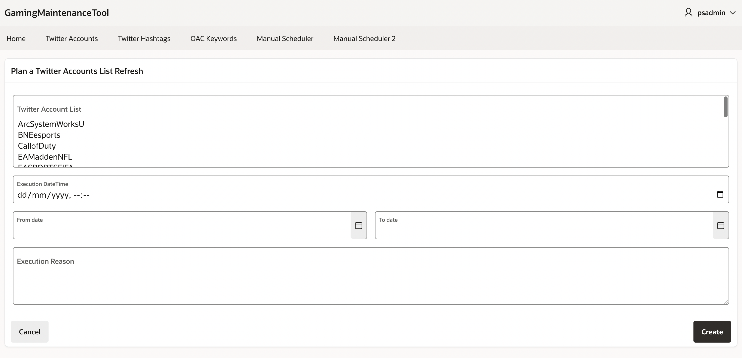
Twitter Scheduler Task for Multiple Twitter Accounts

Slide 29
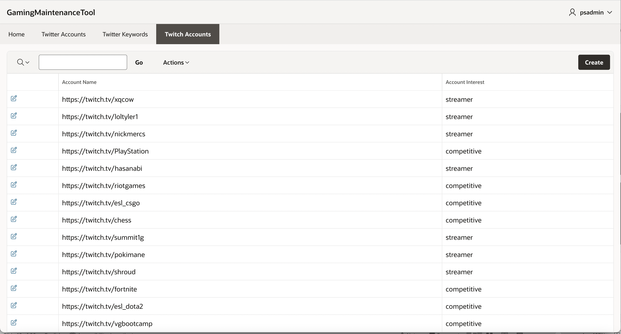
Twitch Accounts Maintenance
1
Select “Twitch Accounts” Tab.
2
Click to modify.

Slide 30
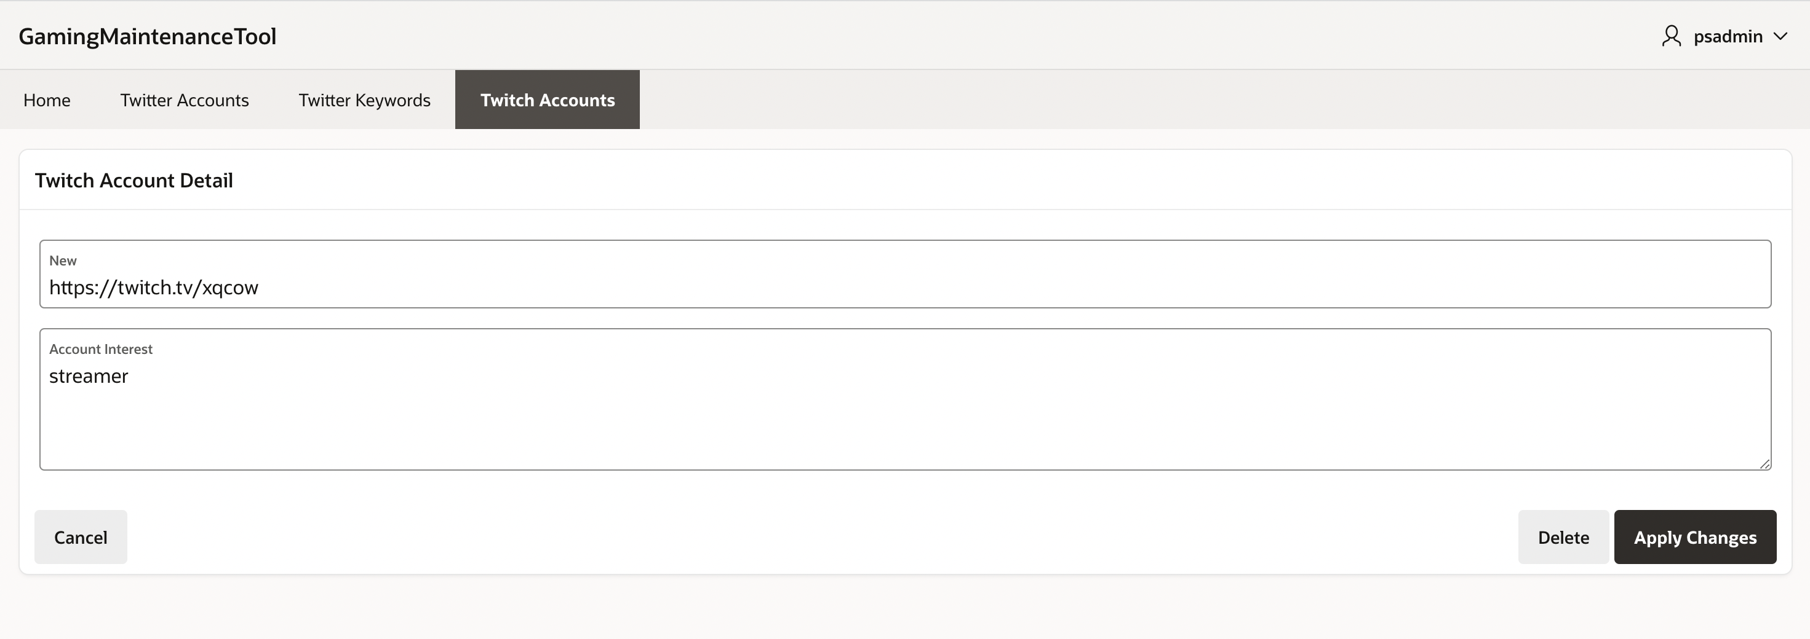
Twitch Account Detail Maintenance

Slide 31
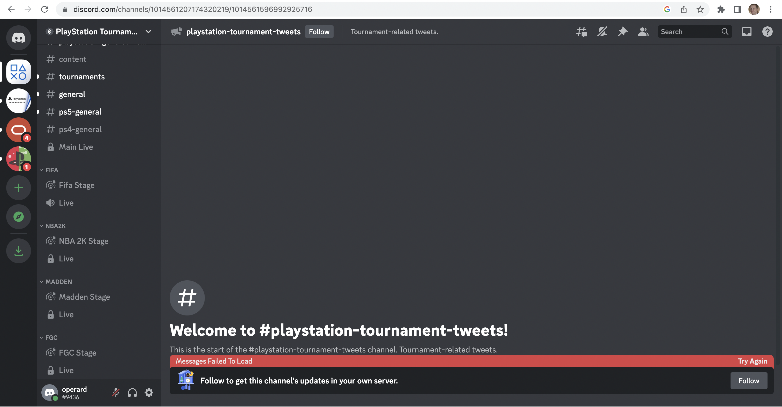
DISCORD Account / Bot
Click to Access to Playstation Tournaments Discord Server.

Slide 32


